Slide 1
Individual Project Presentation
Rana Mittra

Slide 2
Contents
Project Summary
Project Demo
How Training Contributed to the Project
Difficulties
Improvements
Conclusion

Slide 3
Project Summary – Word Generator
What the project was?
Why a word generator?
What the project would need?

Slide 4
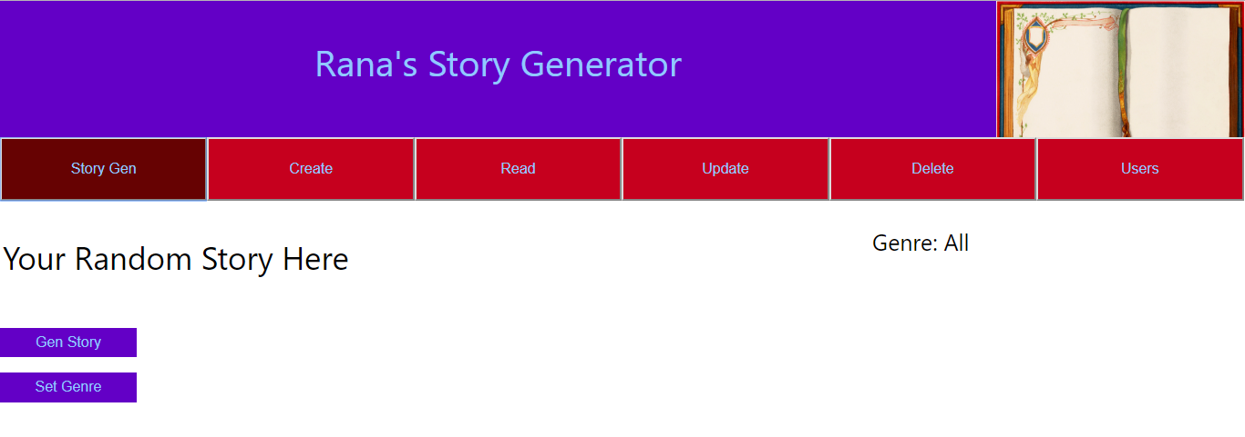
Project Demo
Story Generator

Slide 5
RESTful API diagram
Weeks 4,6
Weeks 4-5
Weeks 2-6
Weeks 4-5
Week 4
Front End
JS and React
HTML
CSS
REST layer
Business Layer
Java SE and EE
Persistence
JPA
Database

Slide 6
Week 1: Organisation
Trello
Gave project sense of direction. Identify priority tasks.
Splitting project into smaller tasks made it more achievable.
What went well: Used project management throughout project.
Use of feature-branch model.

Slide 7
Weeks 2&3: Java
Important as I didn’t know Java, so without this project wouldn’t be possible.
Essential for the business layer.
Learned how good code should be structured.
What went well: Use of SOLID

Slide 8
Weeks 4&5 – Upgrading to EE
Connect business layer to front end
Connect business layer to database and allow objects to persist.
Use of SQL to make a database
Elementary HTML and CSS to make initial front end.
What went well:
Making conditional JPQL queries for random generator.
Working CRUD for two different tables

Slide 9
Week 6 – Front End with JS and React
Upgrading basic HTML website to React.
Used JS to make dropdown menus that control user input.
What went well:
Made functions dependent on user login
Working routers
Use of Axios library for simpler HTTP requests

Slide 10
Week 7 - Testing
Static Testing using Sonarqube
Made a Test Suite.
Use of Moquito to simulate integration testing
>80% coverage.
Code Review by a Peer
Basic Selenium Tests

Slide 11
Week 8 - CI
Set up a VM that allows project to be hosted on a server rather than local host

Slide 12
Challenges
CORS – Fixed allowing 8080 server to allow 3000 server to interact.
Converting to React – Learning states and properly. Functions.
Populating Database – Time consuming rather than difficult.
Preventing null pointers.

Slide 13
Hopes for Improvement
Functional improvement:
More detailed generator
Enable CRUD functions to search by word rather than id number.
Database improvement:
Move to SQL>H2 so changes persist.
Front End improvement:
Make special admin privileges so not everyone can delete sections of the database.
Make Websites more modular.

Slide 14
Summary
Weeks 4,6
Weeks 4-5
Weeks 2-6
Weeks 4-5
Week 4
Front End
JS and React
HTML
CSS
REST layer
Business Layer
Java SE and EE
Persistence
JPA
Database

Slide 15
Any questions?

